Slide 1
Upscaling Basic Sanitation for the Urban Poor (UBSUP)
Construction of DTFs DO´s & DON´Ts

Slide 2
Content
Questions you might to ask yourself:
What is the context of this session?
What are general considerations & directions for the construction of a DTF?
What are specific DO´s & DON´Ts for the construction of the different treatment modules and auxiliary works?
Which safety measures are relevant during construction?

Slide 3
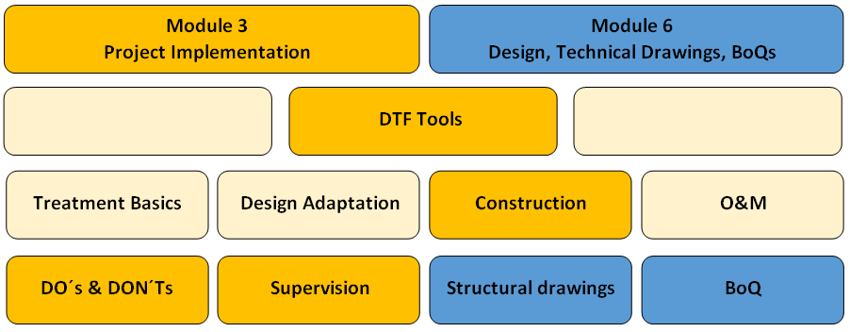
What is the context of this session?
The SafiSan Toolkit
This session

Slide 4
Objective: To make you understand the DTF concept
TREATMENT MODULES
Receiving Bay & Balancing Tank
Co-composting Area
Settler
ABR
Sludge Drying Bed
Constructed Wetland

Slide 5
Objective: To make you understand the DTF concept
AUXILIARY WORKS
Gate & Fence
Operator / Storage Building
Inspection Chambers
Landscaping

Slide 6
General considerations & directions

Slide 7
Why is it required to put so much effort on a simple construction work?
DTF looks like simple concrete structure but the construction reflexes the complex design, which considers
Bio-chemical criteria
Hydraulic criteria
Construction quality is of utmost importance to ensure that the DTF run as designed (or at all) and operate sustainably
Even small leakages lead to environmental pollution and health risks for operators / neighbours
Even small errors in levels can lead to clogging, wrong retention times and overflowing

Slide 8
Which instructions do apply?
The Company Supervisor and the Contractor are responsible to take care that all works are implemented
State-of-the-art (materials, equipment, technologies)
Reliable (honest, in-time, dedicated)
According to technical drawings (i.e. structural)
According to technical specifications outlined in the bid document
According to the information provided in the BoQ

Slide 9
Which sequence of works is recommended?
Works shall be implemented in a logical sequence, not by treatment module, to
Ensure good construction quality
Reduce logistical efforts
Reduce costs related to logistics
Approval of works shall be done in the same order as implementation of works

Slide 10
Which sequence of works is recommended?
Mark total site and treatment modules with cornerstones
Clear site, incl. removal of vegetation
Set temporary benchmark (survey mark) for the entire project time
Excavate all modules and do required landscaping
Build foundations and ground slabs for all modules, incl. proper compacting and blending
Build walls for all modules (incl. inspection boxes)

Slide 11
Which sequence of works is recommended?
Do all piping (inside modules, connecting, drainage, bypass)
Build cover slabs for all modules, incl. manholes
Do water-tight plastering and proper curing
Test system on water tightness
Fill SDRB and VFCW with filter materials and plantation
Test system on operation
Do fencing, final landscaping and construction of access roads, fence and gate

Slide 12
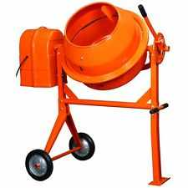
Which sequence of works is recommended?
Example: Construction of ground slabs and foundations
Construction of ground slabs requires a big amount of Reinforced Concrete Cement (RCC)
Quality of mortar is crucial for structural stability and water tightness
Contractor is supposed to use a concrete mixer to ensure proper quality
Constructing all required ground slabs at once avoids bringing the concrete mixer to the construction site various times

Slide 13
What about access to and within the site
Access to the construction site and the possibility to manoeuvre within the site is required for:
Trucks delivering bulk materials: (i) cement, sand and aggregate for mortar (ii) metal bars for reinforcement (iii) gravel for filling the wetland and sludge drying bed (iv) raw water for testing on water tightness / operation
Machinery: (i) concrete mixer (ii) compactors (iii) excavator (iv) bulldozer, etc

Slide 14
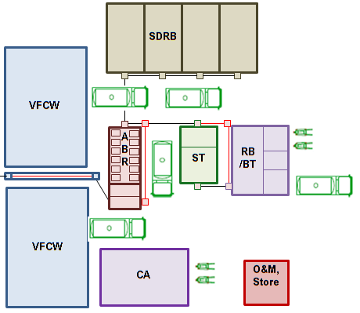
What about access to and within the site?
It might be best to start with modules that are located further away from the access point to the DTF site
Access / space must be considered when establishing the final detailed work programme

Slide 15
How are materials stored to avoid damage?
An elevated and roofed shed is required to store:
Cement to protect from rain and flooding (risk of hardening)
Metal bars and mesh (reinforcement) to protect from rain and flooding (risk of corrosion)
Metal pipes (vent pipes, hand rails for receiving bay) to protect from rain and flooding (risk of corrosion)
Bituminous felt damp-proof course, damp-proof membrane and PE liner to protect from sunlight (UV radiation destroys structure of plastics)
uPVC and HDPE pipes to protect from sunlight (UV radiation destroys structure of plastics)

Slide 16
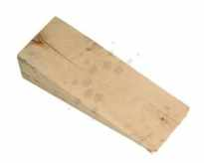
How are materials stored to avoid damage?
A horizontal storage surface required to store:
Metal pipes (vent pipes, hand rails for receiving bay) to avoid deformation
uPVC pipes to avoid risk of deformation
Timber wedge required in between
Metal pipes to avoid risk of scratching
uPVC pipes to avoid risk of scratching
Security and measures against theft required

Slide 17
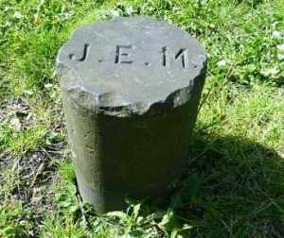
How is the benchmark set?
Levels are crucial to avoid non-performance of the DTF
The benchmark is therefore essential and needs to fulfil the following requirements:
Does not change during the entire project duration in height or location
Protected against obstruction, damage and unintended / accidental relocation
Visible from all points of the construction side (if not possible it must be temporarily transferred during work)

Slide 18
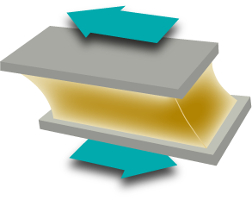
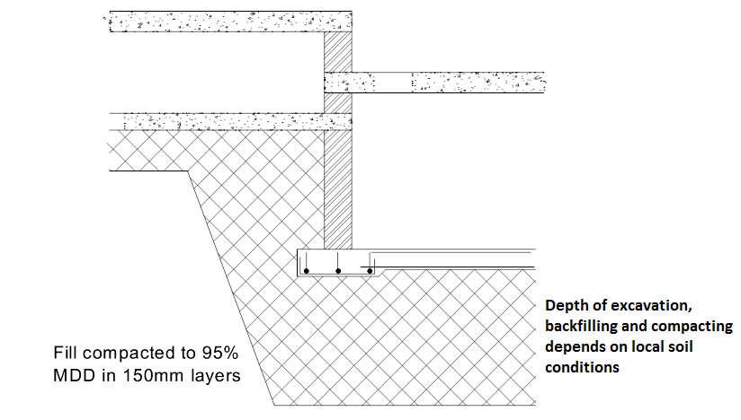
Excavation, backfilling, compacting?
Before constructing foundations and ground slabs, excavation and proper compacting of the underground is essential to:
Reduce subsequent settlement under working loads
Increase the shear strength of the soil
Reduce voids, making it more difficult for water to pass the soil

Slide 19
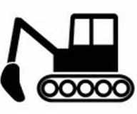
Excavation?
Excavation:
Appropriate depth depends on local soil conditions (e.g. removal of black cotton soil until a hard bed is reached)
In case of underground modules (i.e. settler and ABR) it is likely that hard bed is reached with the depth of the modules
In case of structures on ground level further excavation might be required for proper anchoring of the structures

Slide 20
Backfilling & compacting?
Backfilling
With approved fill material (either excavated soil or imported filler) in layers of 150mm and compacting until a Maximum Dry Density (MDD) of 95% is reached (compaction test)
With a layer of 200mm approved hardcore
Blinding with final material of 25mm thickness
Final compacting of top layer

Slide 21
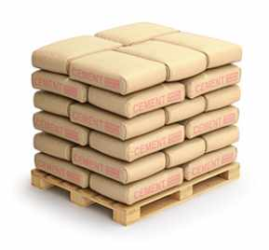
Which mortar is to be used?
A proper concrete mixture is essential to ensure structural stability and water tightness
Ensure that sufficient amount of cement is used Blinding: C15 (1:3:6) Other concrete works: C20 (1:1.5:3)
Ensure the concrete mix is workable, which allows correct placement and consolidation
Use a concrete mixer to ensure perfect blending
Ensure the optimum desired quality of the hardened concrete is met to improve water tightness, wear resistance, and strength

Slide 22
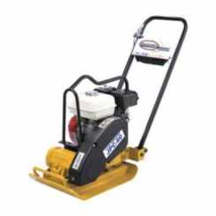
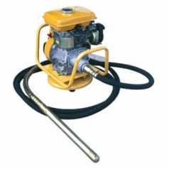
Which mortar is to be used?
Avoid too much water; the quality of concrete mainly depends on the water to cement ratio; the mix should be a stiff as possible
Use the largest aggregate practicable
Use the optimum ratio of fine to coarse aggregate
Ensure proper compacting of blinding and concrete ground / roof slabs to ensure water tightness and structural stability
By default, a compacting machine must be used (a porker vibrator is adequate for this type of works)

Slide 23
What about reinforcement?
Crucial to support the structural stability of ground / roof slabs and walls
To be done according to structural drawings and BoQ
The following materials are to be used:
Metal bars for the (i) strip footing of the ground slab (below walls) and (ii) reinforcement of the cover slab
BRC mesh for the (i) ground slab and (ii) cover slab
Improper reinforcement, e.g. to save material, is not acceptable and the Supervisor and Contractor must be held responsible for any variations from the technical specifications

Slide 24
What about water tightness?
Crucial for all modules (above or underground) to avoid environmental pollution and groundwater contamination
Design includes various construction elements to ensure tightness
Bituminous felt damp-proof course laid under the strip footing
Damp-proof membrane (Gauge 500) laid under the entire ground slab
Internal and external plastering with water proof cement mortar

Slide 25
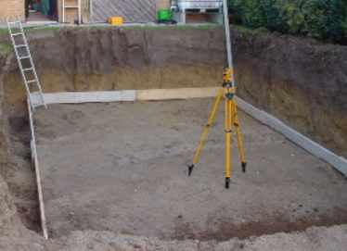
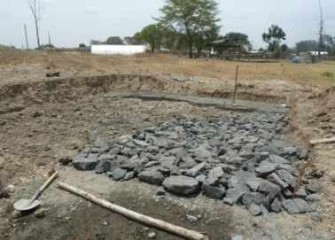
Why is horizontal construction important?
Ensure that ground slabs of all modules are built horizontally to guarantee an equal distribution of
Loads
Settled sludge
Ensured by using a levelling machine and/or tube level

Slide 26
Why is curing so important?
Important due to hot climate conditions and extensive sunlight exposition
Proper curing can be ensured by:
A minimum of 7 days of curing
Only after 21 days the maximum strength will be derived
Freshly cast concrete must be protected against sunlight, drying and evaporation
Frequent watering may be required to keep the concrete moist

Slide 27
What is to be considered during backfilling?
Backfilling with soil (after plastering and curing) poses the risk that the soil pressure damages / destroys walls (cracks)
In order to avoid cracks it is recommended to:
Fill tanks with water during backfilling to compensate soil pressure from outside with water pressure from inside
Fill water gradually into the tanks while the excavation is backfilled with soil

Slide 28
How is water-tightness checked?
Crucial to avoid environmental / groundwater pollution
Required quantities:
A total of 130m³ raw water (borehole or river) are required for the RB/BT + ST + ABR (ABR outlet plugged)
For Wetland and Sludge Drying Bed (without gravel, outlets plugged) approx. 200m³ are required in each case
Water can be reused (e.g. pumped from wetland to sludge drying bed)
For ST and ABR all chambers must be filled simultaneously to avoid unbalanced pressure forces (cracks / collapse)

Slide 29
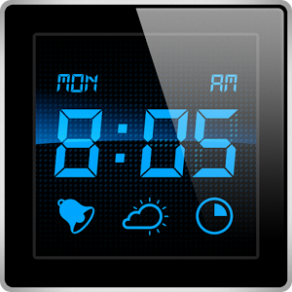
How is water-tightness checked?
Procedure to check tightness:
Mark maximum water level (e.g. with chalk)
Wait for 8 hours
If the water level decreased the Contractor needs to roughen and re-plaster the walls with water-tight mortar (otherwise no completion certificate given)
Contractor and Construction Supervisor are responsible to ensure that all modules are water tight

Slide 30
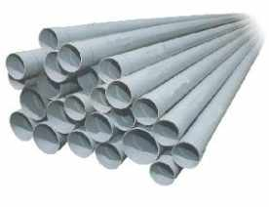
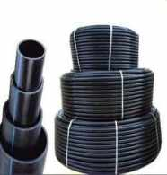
Piping: Which quality of pipes is required?
Contractor and Supervisor must ensure that pipes with adequate diameter, material and thickness are purchased / used, as outlined in the structural drawings and schedule of materials
DN 150 class 41 uPVC (pressure) pipe (e.g. main wastewater / bypass pipes between RB/BT and ST)
DN 100 class 41 uPVC (pressure) pipe (e.g. main wastewater / bypass pipes between after ST, pipes within ST and ABR, drainage pipes)
DN 50 HDPE (pressure) pipe (VFCW distribution system)
DN 100 galvanized iron (GI) pipes (air vents, overflows of inspection chambers)

Slide 31
Piping: Which slope is required?
DTF usually run purely on gravity
Ensure a minimum slope in the pipe network (min. 1%)
Determine the required slope between two points (e.g. outlet of ST and inlet of ABR) by:
Measure the horizontal distance between both points with a measuring tape (the levels are fixed as per design, related to benchmark)
Determine the vertical level difference with a tube level / levelling machine
Calculate the available slope and confirm that it is >1%
s=0.2m/10m=0.02=2%
0.2m
10m

Slide 32
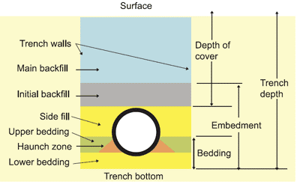
Piping: How are the pipes laid?
Underground pipes (connecting / bypass pipes) must withstand certain loads, i.e. if exhauster trucks pass above
Place pipes on proper sand or gravel bedding (grain size max. 5mm) to prevent breaking
Principal arrangement of a trench for buried pipes, incl. bedding and backfill:

Slide 33
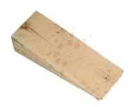
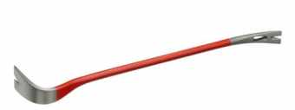
Piping: How are the pipes joined?
Join pipes tightly to avoid leakage (pollution)
Fitting includes the following work steps – especially in case of ST/ABR distribution pipes this is important to ensure correct length
Measure and cut
Prime
Dry fit
Glue (special for PVC pipes, applied on both pipes that are to be joined)
Push and twist
Use a lever rod and a timber wedge when connecting pipes to avoid that pipes get damaged

Slide 34
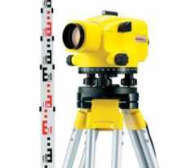
What is the importance of levels?
DTF is supposed to run on gravity (considered during site selection)
To avoid hydraulic problems, the following is essential:
Ensure required levels of slabs and pipes
Avoid any deviation as even small can lead to clogging and overflowing
The Contractor and Supervisor need to ensure that all levels are kept:
Absolute levels of the treatment modules, particularly of the outlet pipes
Required level differences within the treatment modules
Regular checks are required during:
Excavation
Construction of ground slabs and ground bottoms
Installation of pipes (i.e. outlet pipes of modules)

Slide 35
Receiving Bay & Balancing Tank (RB/BT)

Slide 36
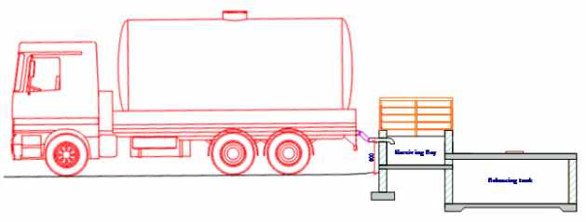
Access to the RB/BT?
The level depends on the levels of the Settler (1% slope)
Depending on the existing ground level excavation or backfilling might be required
Provide a vertical distance between the ground level and the DN 100 inlet pipes of min. 80 cm to connect the truck to the hose
Build the parking area horizontally to ensure that exhausters can be emptied by gravity entirely
0% slope

Slide 37
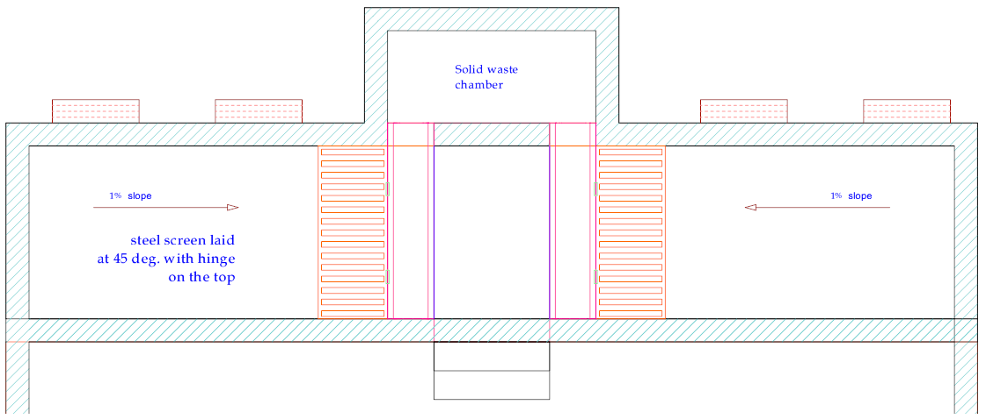
Screens and cleaning channels?
Ensure that screens are exactly built and installed as per spec´s to avoid clogging during operations and facilitate cleaning:
Coarse Screen fabricated using GMS bars with diameter of 20 mm
Spacing between screen bars of 40 mm
Hinge on top to swing open for easier cleaning

Slide 38
Screens and cleaning channels?
Ensure that the concrete U-shape cleaning / drainage channels are built according to the technical specifications:
300 mm wide to avoid clogging
Leading to the solid waste chamber to allow for removal of collected solid waste with a shovel or rake

Slide 39
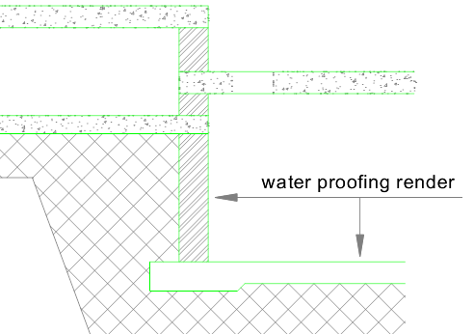
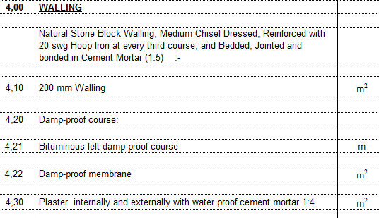
Water tightness?
RB/BT is constructed above ground; leaks would result in groundwater contamination, pollution of the surroundings, smell, attraction of flies, carriers of diseases (health risk to operators)
Build tanks absolutely water-tight:
Plaster walls properly with a water proof cement mortar (incl. plastic additive) - internally and externally

Slide 40
Settler (ST)

Slide 41
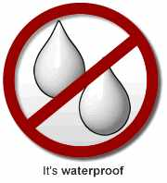
Water tightness?
ST is first treatment step, hence treats untreated faecal sludge
High risk of groundwater pollution as built underground
Build ST 100% water-tight:
Lay felt damp-proof course under the strip footing
Lay damp-proof membrane (Gauge 50) under the entire ground slab
Plaster internally and externally with water proof cement mortar (incl. plastic additive)
Do proper curing of plastering
Test on water tightness and re-plaster if required

Slide 42
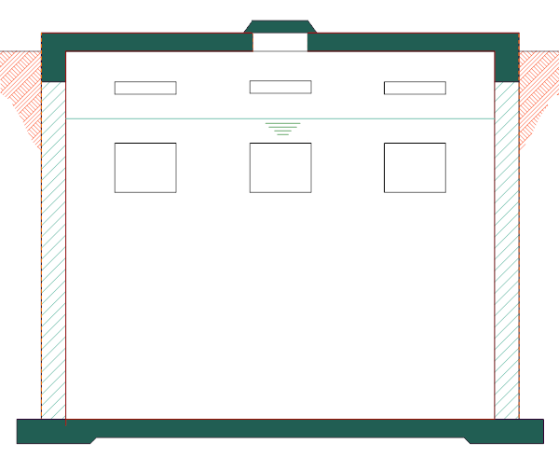
Connections between chambers?
First and second ST chambers need to be connected properly
Allow water flow from the first into the second chamber through three openings that are located below the water level
Allow for gas exchange through openings located above the water level; forgetting might result in cracks or even bursting as only one ventilation pipe exists

Slide 43
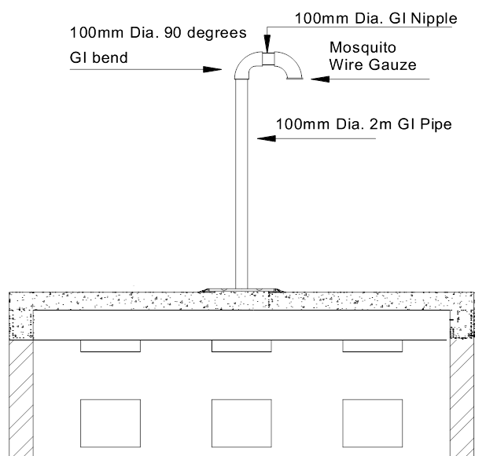
Ventilation?
Generated biogas needs to be released to avoid an increase in gas pressure that would result in cracks or even bursts
Hence one ventilation pipe required (chambers interconnected)
Built in anti-corrosive GI metal
Covered with a 90 degrees GI bend (rainwater)
Mosquito wire gauze (insects)
Extents at least 2 metres above the cover slab (toxic for operator, risk of explosion)

Slide 44
Manholes?
Lots of faecal sludge settles (primary treatment) in the ST and is to be removed regularly by exhauster trucks through manholes:
Two manholes in first chamber (one above the inlet pipe, one close to the separation wall)
One manhole in second chamber (above the outlet pipe)
Located centrally on the slab to allow access to pipes for cleaning
Standard manholes to be used: 600mm x 450mm air-tight plastic manhole covers, placed into a plastic frame

Slide 45
Anaerobic Baffle Reactor (ABR)

Slide 46
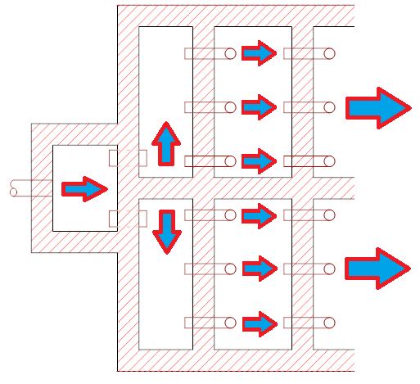
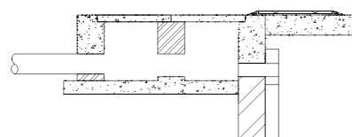
Distribution channel & inlet pipes?
ABR has two separated parallel treatment lines that should treat the same quantity; hence perfect distribution is required
To ensure water distribution over the entire width a distribution channel is needed
Channel follows an inspection box equipped with two outlet pipes
Water is distributed over the entire width as the outlet pipes are slightly elevated above the ground slab of the channel

Slide 47
Distribution channel & inlet pipes?
Assure that the water flows equally through all pipes
Make sure that all outlet pipes are exactly at the same level
Otherwise the water would only flow through the lowest pipe
Entire treatment line useless
Entire treatment line useless & unequal distribution in other line

Slide 48
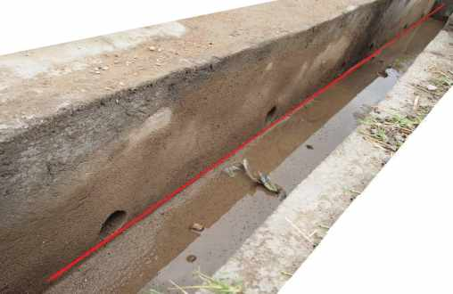
Distribution channel & inlet pipes?
Ensure that all pipes are constructed exactly at the same level
2 outlet pipes of inlet box
6 outlet pipes of the distribution channel
Mark the exact location (bottom of pipe) before installing pipes
Use a levelling machine or at least a level tube for marking levels

Slide 49
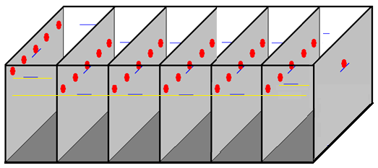
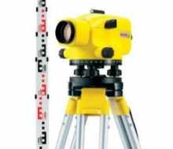
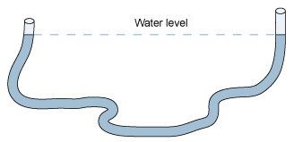
Connection pipes inside ABR?
Mark exact levels at walls before installation
Determine levels with levelling machine / tube level (not distance from slab as slab might not be horizontal)

Slide 50
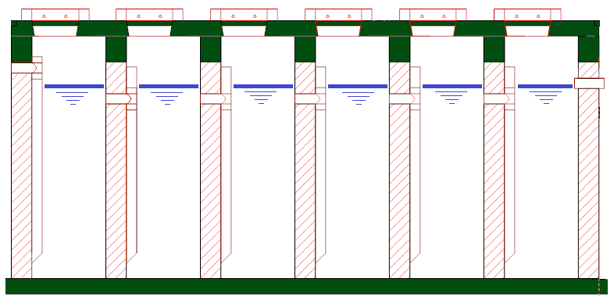
Connection pipes inside ABR?
Water level is determined by the level of the outlet pipe (bottom of pipe); hence 1,850mm above the ground slab
Install inlet pipe 150mm higher than the outlet pipe to ensure a hydraulic gradient
Install inner connection pipes 150mm below the outlet pipe; hence below water level

Slide 51
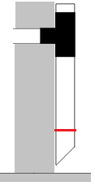
Connection pipes inside ABR?
Six DN100 uPVC inlet pipes per line; hence 36 pipes in total
Reach to the bottom to a distance of 150mm above ground slab
Not be too short to ensure good mixture of wastewater with sludge that is accumulating at the bottom
Not be too long to avoid clogging
Fixed to the walls with clamps to avoid moving and breaking
Upper ends of the pipes must protrude the water level

Slide 52
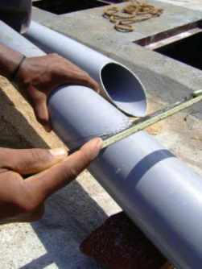
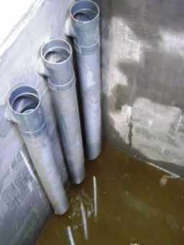
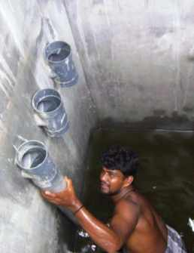
Connection pipes inside ABR?
Cut down-flow pipes at the lower end in an angle of 45 degree
Ensure that the outlet of the pipes is facing the chamber, not the wall
Consider that pipes are to be joined inside the T-pipes, which reduces the length of the pipes after installation

Slide 53
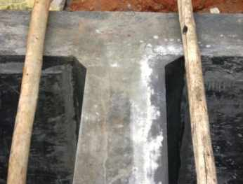
Water tightness?
Provide a damp-proof course to avoid groundwater pollution
Lay felt damp-proof course under the strip footing
Lay damp-proof membrane under the ground slab
Plaster internally and externally with water proof cement mortar (incl. plastic additive)
Cure walls over the next seven days

Slide 54
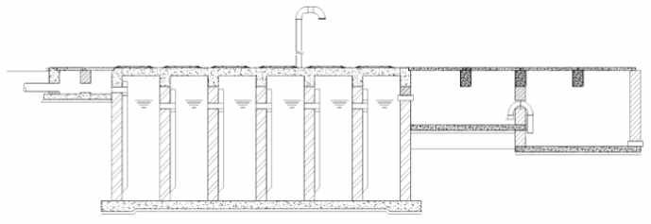
Ventilation?
Methane needs to be released to avoid cracks or even bursts
As only one ventilation pipe is foreseen, all 12 chambers (2 lines) are interconnected to allow gas exchange
Built in anti-corrosive GI metal
Covered with a 90 degrees GI bend (rainwater)
Mosquito wire gauze (insects)
Extents at least 2 metres above the cover slab

Slide 55
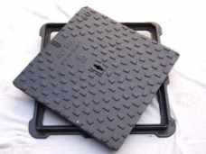
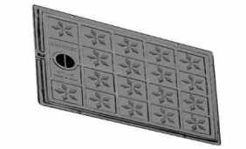
Manholes?
Needs to be de-sludged regularly by exhausters through manholes:
Place in cover slab on top of each of the 12 chambers
Locate centrally to allow access to the inlet pipes (cleaning)
Use standard manholes (to be lifted by one person) : 600mm x 450mm air-tight plastic manhole covers, placed into a plastic frame

Slide 56
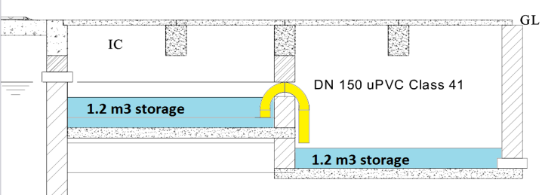
Siphon?
Siphon is intended to load the subsequent wetland intermittently
Proper functioning is crucial for the performance of the entire system
Works purely hydraulically
Dimensions and location determine discharge interval, volume, time, flow velocity, etc.

Slide 57
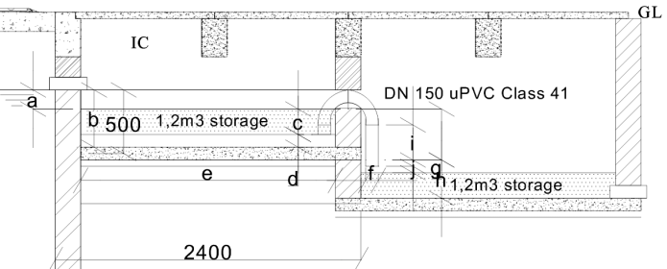
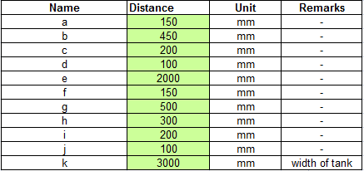
Siphon?
Follow the technical specifications laid out in the structural drawings very carefully

Slide 58
Testing of siphon?
Test siphon on full functionality before approval is given
Test when the entire DTF is tested on water tightness (significant quantity of clear water is required)
Load ABR with clear water (chambers in parallel to avoid cracks)
Water level in the first chamber rises to about 350mm before the siphon starts draining water from the first tank to the second tank
Drainage process will stop automatically after approx 4 minutes
Water level in the first chamber reduces during the drainage interval to approx. 100mm
Process takes place 15 - 18 times per day
Inform DTF Flying Squad during testing and convey results

Slide 59
Electrical wiring?
Install electrical wires only if the siphon needs to be replaced by a submerged pump (decided with WSTF during site selection / design adaptation)
In that case the balancing tank needs to be adapted as only one chamber (pump sump) would be required
If pumping is required:
Install electrical wires in a cable channel underground
Don´t forget to lay a pulling wire into the cable channel
Pull the electrical cable through the channel by means of the pulling wire

Slide 60
Vertical Flow Constructed Wetland (VFCW)

Slide 61
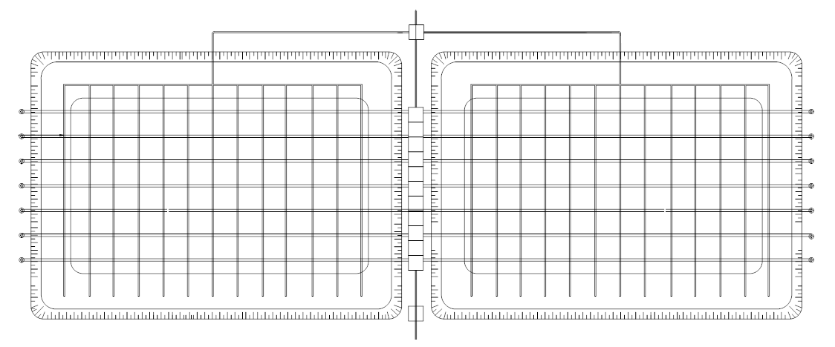
Slope of ground bottom and drainage pipes?
Water trickles through the filter media
Soakage is drained from the ground bottom towards a collection channel that is running in between the two parallel filter beds
Lay drainage pipes in a slope of 0.5% towards the collection channel to ensure gravity-based flow / avoid clogging

Slide 62
Slope of ground bottom and drainage pipes?
Construct the bottom of the filter beds with the same gradient (0,5%) to ensure the required slope within the pipe network:
Create gradient when constructing the clay laver below the filter bed and the PE liner
Place the PVC drainage pipes on top of the PE liner
Contractor and the Construction Supervisor need to check the 0.5% slope of the bottom before the wetland is filled with gravel

Slide 63
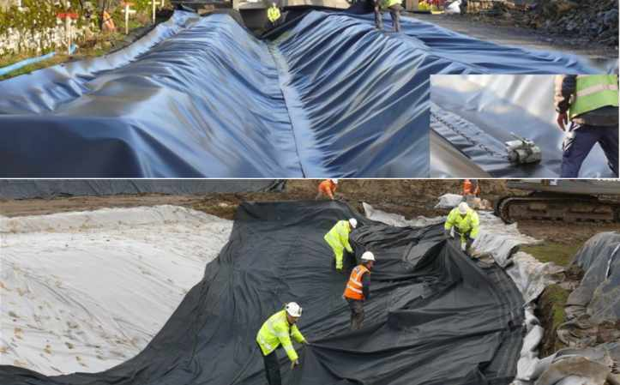
Water-tight foundation?
Water-tight bottom layer is important due to large surface area of the filter beds (prevent water losses and groundwater pollution):
Compacted soil (if required after backfilling with suitable soil)
Clay layer of 100mm thickness
PE liner of 1.5mm thickness

Slide 64
Installation of PE liner?
The following working steps are required for welding of PE liners
Install PE sheets, overlapping by 5 to 10 cm
Prepare and heat weld contact area
Join sheets that are to be connected under welding pressure (either single or double welding seem)
Do controlled cooling of the welding seems under continued pressure
Refinish the welding seems
Inspect the welding seems on water tightness (optically, with scribing iron, test with blowing, pressure or vacuum test)
Correct seems by repeated welding (where required)

Slide 65
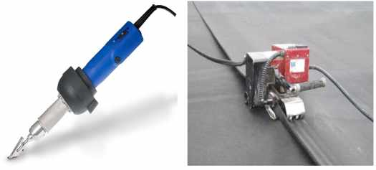
Installation of PE liner?
Fill the filter beds with clear water and monitor the water level on tightness before filling with gravel
Use a specialized Contractor for laying and welding:
Required experience and know-how
Electrical welding machine for wedge / hot air welding of PE liners
e.g. companies specialised on the construction of fish/shrimp ponds, aquacultures and landfills

Slide 66
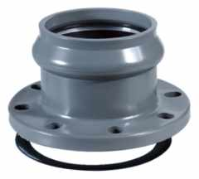
Installation of drainage pipes?
Drainage pipes pass the PE liner before they end in the channel
Joints between pipes and PE liner must be water-tight
Connect inner part of drainage pipe (running at the bottom of the filter bed) with the outer part (connecting the drainage pipe with the collection channel) with a pipe duct (pipe flange)
Flange can be either made of PVC or anti-corrosive metal
Use adapters to connect pipes with commercially available / customized flange
Place PE liner in between two flanges and screw together

Slide 67
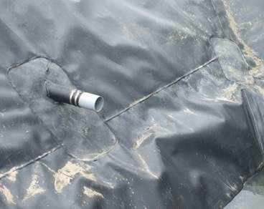
Installation of drainage pipes?
If flanges are not available or feasible, PVC pipes can be connected to the PE liner by welding and use of brackets
Cut a hole into the PE liner where the pipe is supposed to pass the liner
Extent the PE liner by welding additional sheets of PE to it
Put the extended PE liner over the pipe and fixe it with brackets

Slide 68
Installation of drainage pipes?
If neither pipe ducts nor the welding / brackets are available or feasible for any reasons, the connections could be sealed using bitumen or duct tape
This solution is however less durable
Finally the Company and the Contractor should decide which technology they want to use.
It just must be assured that the connection is water tight

Slide 69
Shape of drainage pipes?
Use commercially available DN100 PVC drainage pipe (perforated/slotted)
Are ready-made pipes not available the Contractor might be allowed by the Construction Supervisor to drill holes into regular PVC pipe
Size of the holes / slots must be smaller than 8mm to avoid clogging

Slide 70
Mixture of filter materials?
Ensure that mixtures are uniform to avoid clogging (large, medium, small pebbles are distributed equally in the entire volume)
De-mixing can occur due to individual weights and forms of the different corn sizes during transport to the site (e.g. through vibration of the lorry) or unloading (i.e. in case of tipper trucks)
Larger particles will lay on the bottom-centre of a heap
Assure that de-mixing is minimized by
Careful driving with the lorry to minimize vibrations
Careful unloading, preferably manually instead of tipping
Conscious loading of the filter beds

Slide 71
Mixture of filter materials?
Re-mixing after transport and unloading might be required
The Construction Supervisor needs to confirm to the Contractor that the gravel is ready to be loaded into the filter beds

Slide 72
Installation of filter materials?
Filter bed to be filled in 3 separate(d) layers
Drainage: coarse gravel to (i) ensure an equal distribution of filtrate over the entire bottom area, (ii) to ensure that no small gravel enters the drainage pipes
Filter: finer gravel to provide a large surface area for bacteria to attach, (ii) to act like a mechanical filter, (iii) to provide a large surface for roots to attach
Surface: coarse gravel (i) to avoid clogging of the filter media by allowing the water to infiltrate quickly into the filter beds, (ii) to facilitate an equal distribution of the loaded wastewater over the entire surface area

Slide 73
Installation of filter materials?
Take care of arranging the different filter layers according to the technical drawings
otherwise the treatment performance will deteriorate
to avoid clogging
Procured gravel is often dirty (dust and fine sand / abrasion), or dust/particles occur from unloading
Clean gravel with water to flush off dust and sand before filling of the filter beds

Slide 74
Installation of filter materials?
Sharp edged material / quarry stones
can lead to damage of the PE foil sealing (no water-tightness)
may impede the development and growth of the vegetation
Ensure that only round gravel (e.g. river pebbles) is used (no quarry stones)
especially for the drainage layer

Slide 75
Installation of filter materials?
Ensure that the filter material is not compacted during incorporation
No (very limited) stepping on the filled material
In order to avoid soil compaction, filling is to take place from supporting planks

Slide 76
Distribution pipes?
DN50 HDPE perforated pipes to be used as distribution pipes
laid in parallel
laid in 1m distance
laid within the surface layer of the filter beds
slightly covered by the 8/16 gravel to avoid / reduce smell, mosquito breeding, sunlight exposition, damage during O&M
8/16 gravel
DN50 HDPE pipes
4/8 gravel

Slide 77
Distribution pipes?
Lay pipes in a slight slope of 0.5% towards the end of the filter beds to ensure that the water is distributed over the entire surface
Create slope during placement of the pipes
Use perforated pipes with holes of 10mm diameter
Place holes every 1 running meter

Slide 78
Planting of filter beds?
Common reed (phragmites australis) is the most common plant used
Reed can be planted as clumps, individual rhizomes or as seedlings
Clumps can be planted all year round, preferably during the rainy season; 2 clumps per m²
Rhizomes are planted when the rhizomes have one or two 10 - 60 cm shoots; 4 – 6 rhizomes per m²
Seedlings (developed in greenhouses) are planted if they show the start of rhizomes; easier to plant than pieces of rhizome and grow lushly in the first season; 3 - 5 seedlings per m² are sufficient

Slide 79
Planting of filter beds?
Avoid soil compaction by planting from supporting planks
Provide plant beds immediately following construction with a freeboard of 20 -30 cm (distance from the bed surface to the upper edge of the sealing)
Fix edge of the sealing (PE liner) with gravel to avoid destruction / removal of the PE liner and for visual reasons
Water plants during construction, commissioning and first months of operation (if no rain) until they have reached a height of some 50cm

Slide 80
Drainage / bypass channel?
Soakage of the filter beds is routed via drainage pipes (0.5% slope) into drainage channel
Running in between the two filter beds
Construct the channel with a slope of 1% to avoid clogging
Used as bypass (if both beds are closed down for any reason)
Channel is covered by precast concrete covers
Y10 lifting handle rings to provide easy access for cleaning
Do not exceed 600mm x 600mm x 50mm for weight reasons

Slide 81
Effluent pipe?
Inspection chamber is placed at the end of the drainage channel
From this chamber the effluent shall be routed through a DN100 uPVC pipe towards the receiving water body (i.e. a river or trench)
Lay pipe with at least 0.5% slope (1% if topography allows)
Place inspection chambers every 25 meters to allow access to the pipe system for cleaning in case of any clogging
Use standard inspection chambers with the dimension of 1200mm x 825mm, covered with 600mm x 450mm x 50mm PVC covers

Slide 82
Sludge Drying Reed Bed (SDRB)

Slide 83
Level?
Level depends on the level of a nearby treatment module
Ensure a slope of min 0.5% in the connecting pipe
Backfill if required as per existing ground level
A parking area / ramp might be required
Horizontal to ensure that exhausters can be emptied by gravity
Height must ensure that the truck outlet is higher than the surface of the SDRB
0% slope

Slide 84
Slope of ground and drainage pipes?
Soakage is drained from the ground towards a collection pipe
Provide ≥0.5% slope in the drainage pipes to allow for gravity flow
Build ground of the drying chambers with a 5% slope towards the drainage pipe to allow easy collection of the soakage
Create 5% slope during construction of clay layer
Check slope before PE liner and drainage pipes are installed

Slide 85
Water tightness?
Similar to the VFCW, seal the bottom water-tight
Same working steps as for VFCW: (i) compact soil, (ii) construct a 100mm thick clay layer, (iii) install a 1.5mm PE liner
Same installation of PE liner as for VFCW: (i) overlapping installation of PE sheets, (ii) preparation and joining of sheets by overlap welding, (iii) cooling and refinishing of welding seems, (iv) inspection on water-tightness, and (v) corrections as required
Again, an experienced Contractor with electrical welding machine PE liners required
Install the PE liner of SDRB at same time as for VFCW
Ensure a water-tight passage of PVC pipes through the PE liner (flange; welding & bracket)

Slide 86
Mixture and installation of filter material?
Fill different filter layers as required to avoid clogging
Use round gravel (e.g. river pebbles) for the drainage / rock layer to avoid that PE liner gets damaged by sharp edged stones
Avoid compaction of filter material during filling (use planks)
Wash filter material before loading

Slide 87
Plantation?
Similar to plantation of VFCW

Slide 88
Co-composting Area (CA)

Slide 89
Level?
Construct slightly above ground level to avoid that rainwater runoff flows into the shed during heavy rainfall
Elevation of at least 30cm above the surrounding ground level
Ensure level by means of adequate landscaping during construction
Build drainage channels around the shed to reduce the required elevation (if preferred)

Slide 90
Drainage channels?
Leachate might (!) be generated during the composting process and should be drained to avoid nuisances
Construct longitudinal drainage channel in the centre of the CA
Provide a slope of 1% towards the intended drainage side
Create channel and its slope during the plastering of the platform
Provide a slope of 1% towards the drainage channel in the platform during plastering of the ground slab The leachate can be infiltrated into the ground by means of a small pit filled with gravel

Slide 91
Supporting columns for roof?
Roof has a considerable weight (steel truss, roofing sheets)
Ensure good construction quality for the supporting columns
Proper quality of square hollow section (SHS) columns, metal plates and bolts (anti-corrosive)
Proper cement mixture (C20) for concrete pillars
Proper use of formworks during construction
Proper installation of the bolts into the concrete pillars to allow for easy installation of the metal plate
Proper fixing of the screw nuts on the bolts, avoiding any kind of friction that could result in damaging the concrete pillars

Slide 92
Supporting columns for roof?
Good construction quality is crucial to ensure that the roof resists rough weather conditions such as heavy rain or storms

Slide 93
Chambers & Pipes

Slide 94
Types of inspection chambers?
Two kinds of inspection chambers are foreseen for the DTF:
Standard chamber to a depth of 1m below ground level
Standard chamber to a depth of more than 1 meter

Slide 95
Location of inspection chambers?
Inspection chambers are generally located:
Every 25 meters to provide access to buried pipes
Where the flow direction of pipes changes, i.e. in case of bypasses

Slide 96
Plugging of pipes?
Pipes, particularly bypasses, need to be plugged
Use regular plastic plugs / end caps for plugging the PVC pipes:
End cap that is pressed outside the normal end of a pipe
Plug that is pressed inside the socket (recommended as the pipe end has a rubber sealing; hence the plugging is water-tight)
Fix plugs permanently to the inspection box with a rustproof, stainless steel chain to avoid theft

Slide 97
Plugging of pipes?
Assure that pipes are placed in a way that the sockets are accessible in order being able to close pipes with plugs from inside
Ensure that the pipe end finishes with the plastering of the inspection box (it is not required to build any kind of channel)
If the sockets are not accessible in an inspection chamber, the pipe cannot be plugged

Slide 98
Flow regulation at Receiving Bay?
Main flow into the system is regulated to ensure a steady flow and to avoid peaks
Place a penstock sliding valve at the outlet pipe of the Balancing Tank
The inspection chamber also hosts outlets to the settler (bottom of chamber), a bypass (slightly elevated), as well as an overflow (on top of chamber)

Slide 99
Flow regulation upstream Wetland?
Flow is diverted between the intermittently operating filter beds
A volume-wise flow regulation is not required
Place PVC ballcock valves into the DN50 HDPE feeding pipes leading to the filter beds
Plug the bypass pipe in an attached dry chamber

Slide 100
Flow regulation upstream Wetland?
Ballcock valve
Arrangement of 2 ballcock valves and outlet to bypass (to be plugged in second chamber)

Slide 101
Covers?
Build all covers as per technical specifications:
Inspection chambers
inlet/outlet boxes of treatment modules
Distribution channels
Balancing tanks and treatment modules
Ensure that the manhole covers can be lifted easily by one person (DTF operator)
Fix PVC covers permanently to the inspection box with a rustproof, stainless steel chain to avoid theft
Equip covers with a moveable ring handle to avoid risk of stumbling or use standard covers with 2 small halls for hooking it up with e.g. screwdriver

Slide 102
Operator / Storage Building

Slide 103
Water supply?
Connect the building to water supply
O&M purposes (cleaning of equipment)
Personal hygiene (water flush toilet, hand washing)
Install a water tap outside the building for cleaning boots, tools, etc. before entering the building
Supply fresh water either by
Pipe network
Rainwater harvesting
Borehole or a well
Cistern filled occasionally by lorries

Slide 104
Energy supply?
If possible by any means, supply the building with electricity
Lighting
O&M
This can be done by
Connection to a nearby power grid
Equipping the building with a solar system
Side note: energy supply is required anyhow if the decision was taken during the site selection and design adaptation phase to install a pump instead of a siphon to load the wetland system

Slide 105
Drainage?
Drain and treat generated wastewater, as the building is equipped with a wash basin and toilet
Connect the building by gravity to a DTF treatment module, i.e. the receiving bay, settler or ABR

Slide 106
Auxiliary Works

Slide 107
Final landscaping & drainage?
A general risk of flooding exists during rain events (dilution, reduced treatment capacity)
Ensure that all modules are not prone to flooding during rain
Co-composting area is independent
Build the co-composting area above the existing / or final ground level
Avoid flooding of the other modules (levels depend on receiving water body) by final landscaping and proper drainage
Ensure that cover slabs of settler, ABR, inspection chambers extent at least 20cm above final ground level (freeboard)
Ensure that barriers of the wetland system and sludge drying beds extent at least 30cm above final ground level (freeboard)
Flatten the site to allow access to all modules for trucks and SaniGo

Slide 108
Fence?
Take care to locate the fence appropriately and as per design
Ensure sufficient distance between treatment modules and fence (incl. space that trucks can access all modules for O&M)
Avoid access to the site for unauthorised persons to avoid damages, theft and personal injuries; particularly children
Ensure that the fence is not installed outside the assigned land to avoid legal problems
Ensure that the fence is located at solid grounds, or ensure proper foundation, in order to ensure structural stability
Follow the technical specifications to ensure structural stability

Slide 109
Gate?
Location of the gate is determined during the final design
Ensure during construction that the gate is constructed in a way that guarantees:
Easy access of exhauster trucks to the receiving bay, having in mind required manoeuvring
Easy access of exhauster trucks and SaniGo to the gate from outer roads

Slide 110
Health and Safety

Slide 111
Basic rules for safety?
Tidy construction site
Keep passages clear all time to avoid stumbling, stepping into nails
Pile materials safely; stacks should not be too high
Beware of floor openings and ensure that they are covered
Remove waste as soon as possible
Safety Measures
Ensure that dangerous part of machines have been installed with a guard
Keep vigilant all the time and watch out for moving equipment
Before you use any electrical tool, check the condition of its cables
Avoid dragging electric cables on the ground or allowing the cables to come into contact with water

Slide 112
Basic rules for safety?
Personal safety
Wear protective equipment
Do not drink or take drugs while working
Pay attention to personal hygiene
Do not play in the workplace
Report to your supervisor immediately if you notice any unsafe condition

Slide 113
Emergency Response?
Have a good understanding of your working environment
When evacuation is required in an emergency, you should keep calm and find out
What dangerous situation the alarm refers to
The routes for evacuation
The safe place that you should go to as designated by the company

Slide 114
Emergency Response?
If an accident happen despite safety precautions it is important to:
Keep calm
Seek help immediately
Accompany the injured person
Assist in the immediate rescue work as far as possible
Do not try to move the injured person unless it is really necessary

Slide 115
Emergency Response?
When a fire breaks out, you should remember:
Put out the fire with a fire extinguisher if it is a small fire
If the blaze is out of control, do not try to extinguish the fire on your own; call the Fire Services Department, or the police (999) right away

Slide 116
HEALTH & SAFETY EXAMPLES?
Excavations
Use safe access for ingress and egress
Do not pile soil or any other materials at the edge of an excavation
Make sure that a trench is securely shored before working in it
Gas welding & flame cutting (i.e. for roof of composing area)
Wear personal protective equipment (i.e. safety glasses)
Place fire extinguishers within reach
Keep gas cylinders upright and secure it against overturning
If gas leakage is detected, report it to your supervisor immediately

Slide 117
HEALTH & SAFETY EXAMPLES?
Fire risk
Always keep the workplace clean and tidy
Handle machinery and tools that may generate sparks or heat carefully
Do not smoke or use naked flames in any area where flammable and explosive substances are stored
Know where fire extinguishers are located and how they are used
Know the place of assembly for fire evacuation

Slide 118
HEALTH & SAFETY EXAMPLES?
Waste disposal
Dispose all wastes and unwanted materials must be disposed of at a designated place
Separate disposal of chemical or inflammable wastes
Do not leave planks with nails on passageways
Eye protection
A small fragment entering an eye may cause serious consequences
Wear suitable eye protectors when there is a risk of eye injury, such as in concrete breaking
Take proper care of the eye protectors provided to you; replace damaged eye protectors immediately

Slide 119
HEALTH & SAFETY EXAMPLES?
Noise
Wear ear protectors in areas with high noise levels
Do not reuse disposable ear plugs
Clean ear protectors regularly
Personal Protective Equipment
Wear gloves when handling or contacting chemicals
Wear a mask when working in a dusty environment
Wear eye and ear protectors whenever necessary
Wear safety shoes to prevent foot injury
Wear a safety helmet on a construction site

Slide 120
HEALTH & SAFETY EXAMPLES?
First Aid
Ensure that a first aid kit is available at the construction site
Identify in advance a colleague who is trained in first aid procedures
Manual handling
Avoid manual handling operations as far as possible
Lift an object with a correct posture (e.g. straight back)
Put on gloves to protect your hands from cuts, scratch or puncture
Wear safety boots or shoes to prevent injury to toes by heavy falling objects
Seek assistance from someone in lifting a load if necessary

Slide 121
Do you have any questions, remarks or suggestions?

